Slide 1
SORTING
BUBBLE AND SELECTION

Slide 2
Sorting Real Life Example
Telephone Directory: It is a book that contains telephone numbers and addresses of people in alphabetical order.
Dictionary: It is a huge collection of words along with their meanings in alphabetical order.
Contact List: It is a list of contact numbers of people in alphabetical order on a mobile phone.

Slide 3
Types of Sorting
The different types of order are:
Increasing Order: A set of values are said to be increasing order when every successive element is greater than its previous element. For example: 1, 2, 3, 4, 5. Here, the given sequence is in increasing order.
Decreasing Order: A set of values are said to be in decreasing order when the successive element is always less than the previous one. For Example: 5, 4, 3, 2, 1. Here the given sequence is in decreasing order.
Non-Increasing Order: A set of values are said to be in non-increasing order if every ith element present in the sequence is less than or equal to its (i-1)th element. This order occurs whenever there are numbers that are being repeated. For Example: 5, 4, 3, 2, 2, 1. Here 2 repeated two times.
Non-Decreasing Order: A set of values are said to be in non-decreasing order if every ith element present in the sequence is greater than or equal to its (i-1)th element. This order occurs whenever there are numbers that are being repeated. For Example: 1, 2, 2, 3, 4, 5. Here 2 repeated two times.

Slide 4
Sorting Techniques
Bubble
Selection
Insertion Sort
Merge Sort
Quick Sort
Heap Sort

Slide 5
Bubble Sort
Bubble Sort is the simplest sorting algorithm that works by repeatedly swapping the adjacent elements if they are in the wrong order.
Bubble Sort algorithm, sorts an array by repeatedly comparing adjacent elements and swapping them if they are in the wrong order.
The algorithm iterates through the array multiple times, with each pass pushing the largest unsorted element to its correct position at the end.
Code includes an optimization: if no swaps are made during a pass, the array is already sorted, and the sorting process stops.

Slide 6
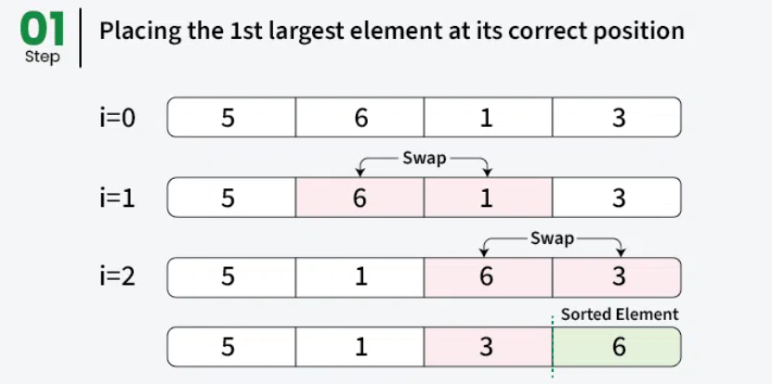

Slide 7
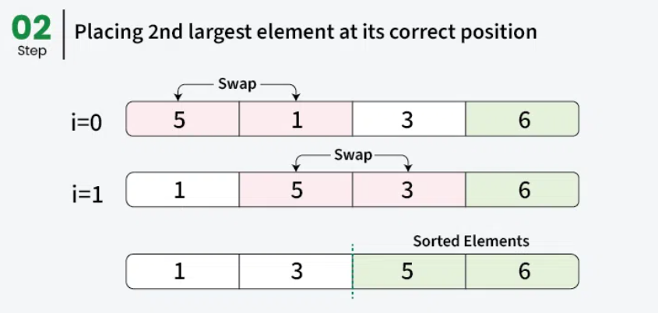

Slide 8
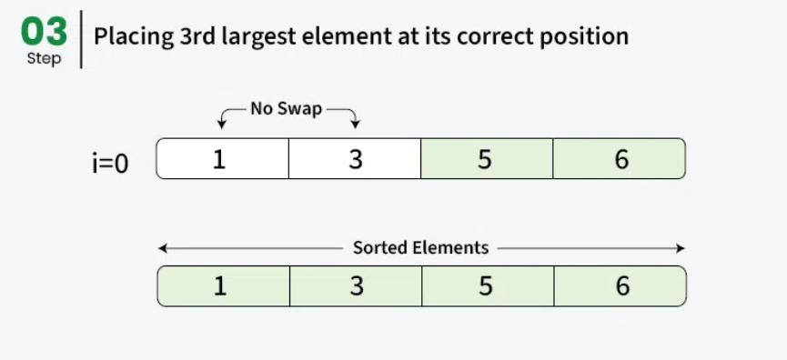

Slide 9
mylist = [7, 3, 9, 12, 11]
n = len(mylist)
for i in range(n-1):
swapped = False
for j in range(n-i-1):
if mylist[j] > mylist[j+1]:
mylist[j], mylist[j+1] = mylist[j+1], mylist[j]
swapped = True
if not swapped:
break
print(mylist)

Slide 10
Big O Notation
Time Complexity: O(n2). However in practice, this optimized version might take less time as when array gets sorted, function would return.
Auxiliary Space: O(1).

Slide 11
SELECTION SORT
Selection Sort is a comparison-based sorting algorithm. It sorts an array by repeatedly selecting the smallest (or largest) element from the unsorted portion and swapping it with the first unsorted element. This process continues until the entire array is sorted.
First we find the smallest element and swap it with the first element. This way we get the smallest element at its correct position.
Then we find the smallest among remaining elements (or second smallest) and swap it with the second element.
We keep doing this until we get all elements moved to correct position.

Slide 12
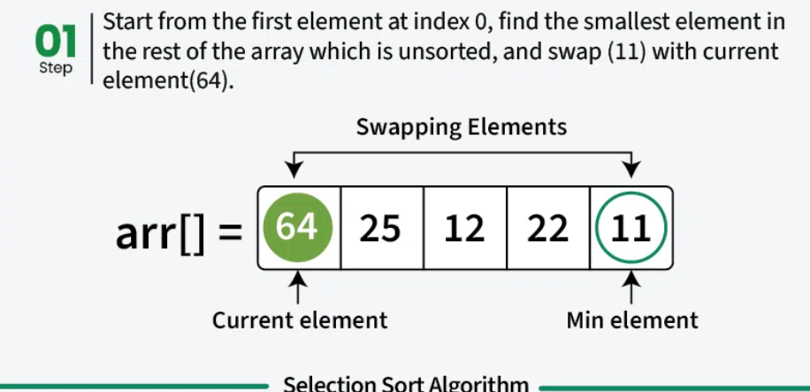

Slide 13
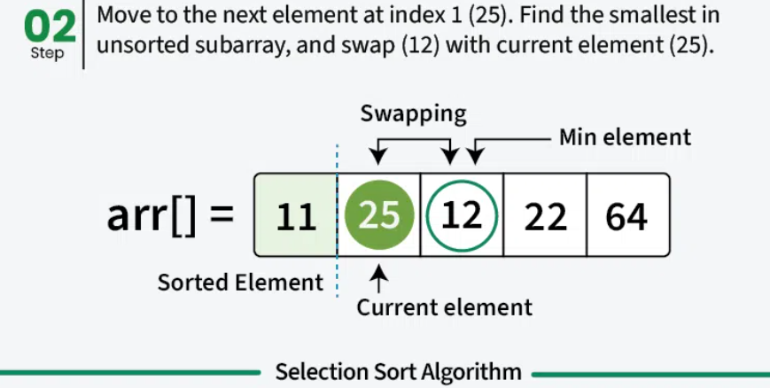

Slide 14
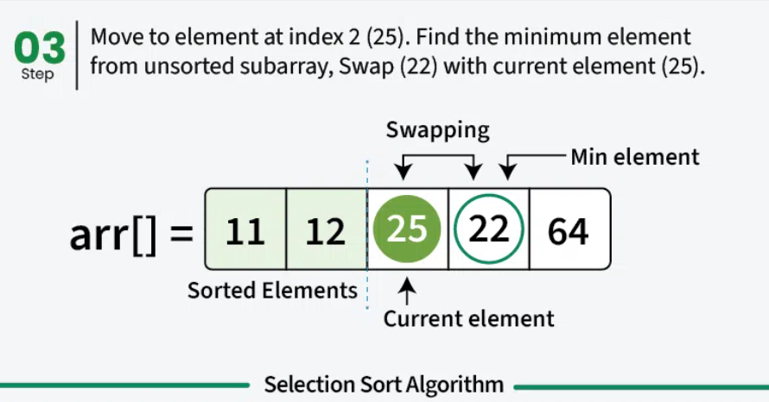

Slide 15
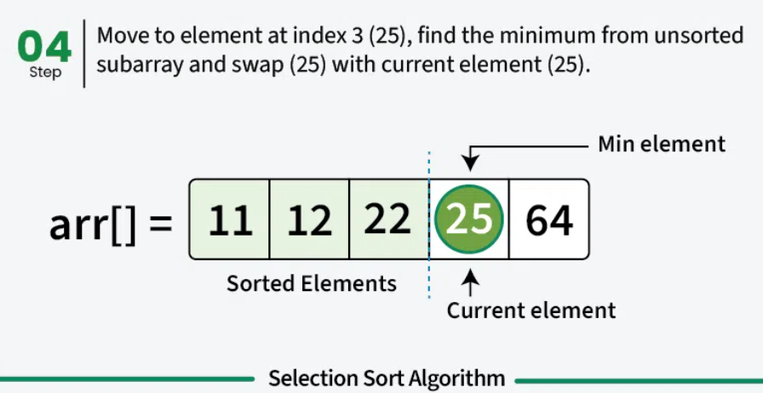

Slide 16
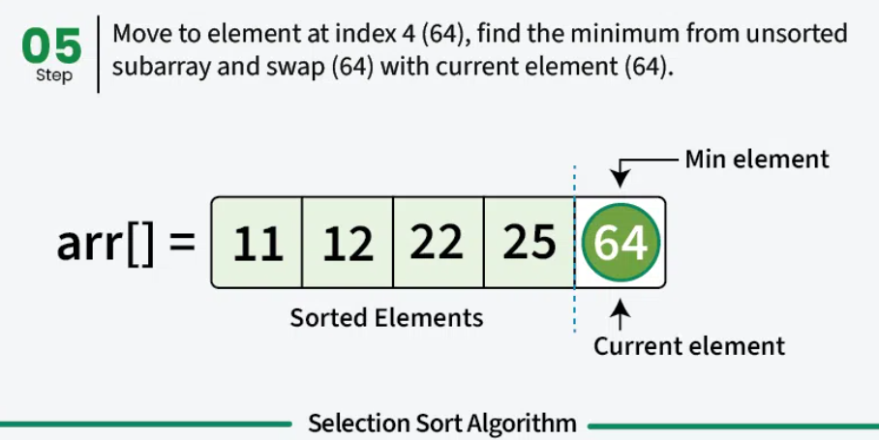

Slide 17
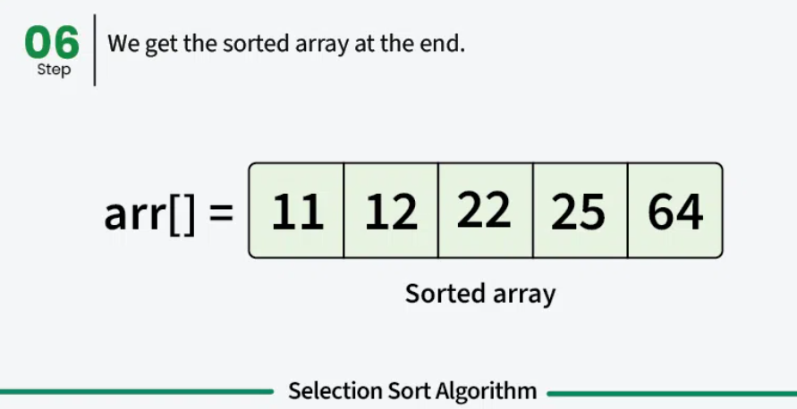

Slide 18
mylist = [64, 34, 25, 12, 22, 11, 90, 5]
n = len(mylist)
for i in range(n):
min_index = i
for j in range(i+1, n):
if mylist[j] < mylist[min_index]:
min_index = j
mylist[i], mylist[min_index] = mylist[min_index], mylist[i]
print(mylist)

Slide 19
Time Complexity: O(n2).
Auxiliary Space: O(1).

Slide 20
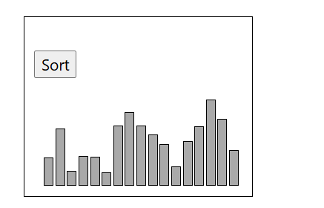
Insertion Sorting
The Insertion Sort algorithm uses one part of the array to hold the sorted values, and the other part of the array to hold values that are not sorted yet.
The algorithm takes one value at a time from the unsorted part of the array and puts it into the right place in the sorted part of the array, until the array is sorted.

Slide 21
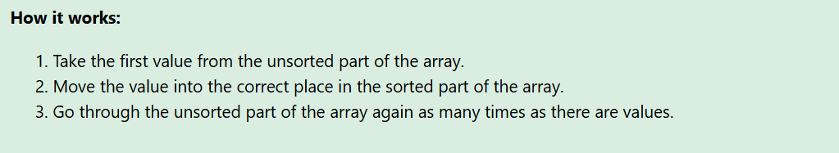
Manual Run Through
Before we implement the Insertion Sort algorithm in a Python program, let's manually run through a short array, just to get the idea.
Step 1: We start with an unsorted array.
[ 7, 12, 9, 11, 3]

Slide 22
Step 2: We can consider the first value as the initial sorted part of the array. If it is just one value, it must be sorted, right?
[ 7, 12, 9, 11, 3]
Step 3: The next value 12 should now be moved into the correct position in the sorted part of the array. But 12 is higher than 7, so it is already in the correct position.
[ 7, 12, 9, 11, 3]
Step 4: Consider the next value 9.
[ 7, 12, 9, 11, 3]
Step 5: The value 9 must now be moved into the correct position inside the sorted part of the array, so we move 9 in between 7 and 12.
[ 7, 9, 12, 11, 3]

Slide 23
Step 6: The next value is 11.
[ 7, 9, 12, > 11, 3]
Step 7: We move it in between 9 and 12 in the sorted part of the array.
[ 7, 9, 11, 12, 3]
Step 8: The last value to insert into the correct position is 3.
[ 7, 9, 11, 12, 3]
Step 9: We insert 3 in front of all other values because it is the lowest value.
[ 3,7, 9, 11, 12]
Finally, the array is sorted.

Slide 24
mylist = [64, 34, 25, 12, 22, 11, 90, 5]
n = len(mylist)
for i in range(1,n):
insert_index = i
current_value = mylist[i]
for j in range(i-1, -1, -1):
if mylist[j] > current_value:
mylist[j+1] = mylist[j]
insert_index = j
else:
break
mylist[insert_index] = current_value
print(mylist)

Slide 25
